Slide 1
Achievement Awards Scheme

Slide 2
Titles
Sir Jack Petchey CBE

Slide 3
Jack Petchey’s timeline to success!
1925
Jack Petchey was born in East London
1947
£37 - The payment Jack received when he left the Royal Navy in 1947
1948
They told him that he was: “Not Management Material”
1999
Jack Petchey Foundation was founded
2019
Over £118 million given since 1999

Slide 4
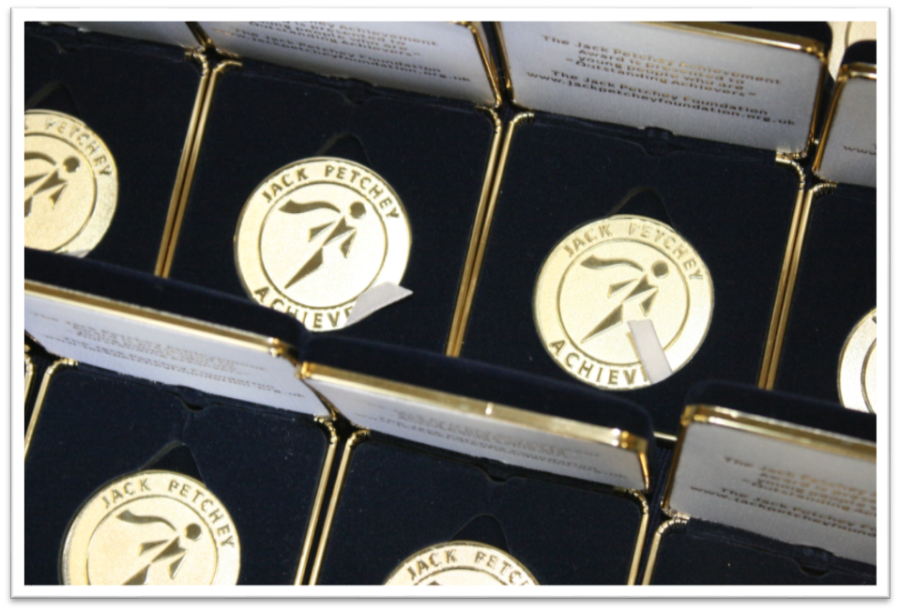
To date, 180,000 Achievement Awards have been presented!
The scheme currently operates in almost 2000 groups and schools across London and Essex

Slide 5
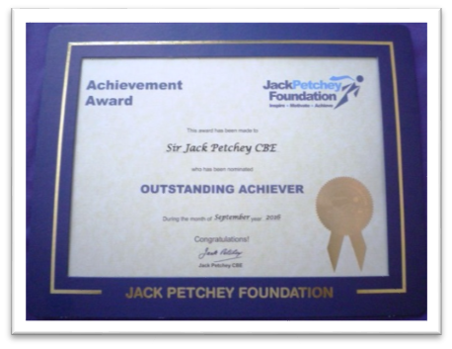
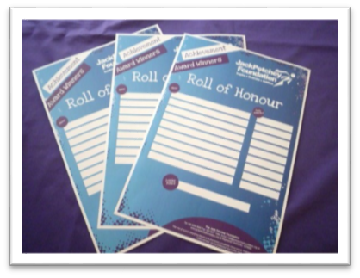
We provide you with fantastic materials

Slide 6
How does it work? - We provide a handy “Hints and Tips” guide
This guide is in your pack - please read it and put it on your notice board!

Slide 7
How many award winners will we nominate each year?
Bronze Scheme – Entitles you to 3 award winners a year or 1 per term
Silver Scheme – Entitles you to 6 award winners a year or 2 per term
Gold Scheme – Entitles you to 9 award winners a year or 3 per term

Slide 8
Who should win?
Remember – these awards are NOT about “being the best!”
They are about “doing your best”
Use the awards to recognise those special young people in your club/school.
Perhaps those who are always:
Helping others, being a good role model, coping with adversity, doing community work, giving service within the community or maybe just trying really hard!

Slide 9
Nominating and selecting a winner
Young people, staff and parents can nominate using nomination forms, or perhaps as part of a discussion.
Involve the young people in choosing the winner too! This could include a small group of previous winners.
Remember - Nominees must be aged 11-25 and can only receive the award ONCE during their time at your group

Slide 10
Presenting the award
Present the winner with their certificate, pin badge, membership card and congratulations leaflet in front of their peers perhaps during a special session
Make sure everyone knows why they have won

Slide 11
Spending the money
Create a “wish list” of items - this can include equipment, activities, trips out, hiring a specialist worker, a celebration event, training courses… be imaginative!
The winner decides how the £250 is spent—once the decision is made…SPEND IT!
The money must NOT go towards standard running costs and must be used for the benefit of a group of young people and NOT for an individual.

Slide 12
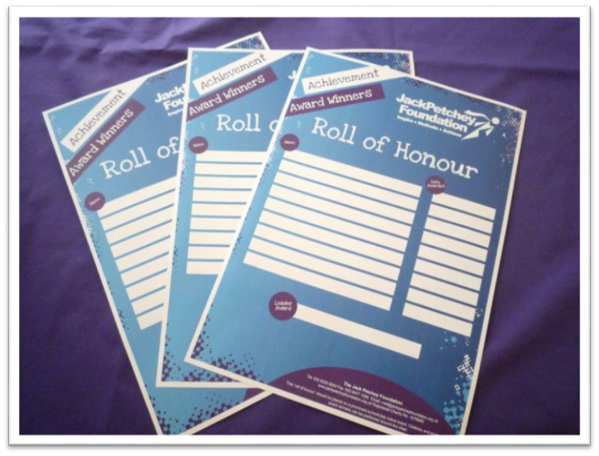
Celebrating achievement
Publicise the success of your young people by including information about who won awards and why and how they have spent the money.
Publicise winners on your notice board, in newsletters, on your website, and social media – we provide a “Roll of Honour” wall chart in your pack to help you do this.

Slide 13
Recognising Leader Award winners
This is a great way to recognise that special adult, they could be staff, volunteer, parent, manager or other significant adult aged 21+.
Complete the simple on line application form on our website. The winner will then qualify to apply to the Small Grants to fund a project, equipment or trip of your choice up to the value of £750.

Slide 14
Medallion presentations
All winners are entitled to attend a prestigious Regional (Clubs) or Borough (schools) medallion event every year.
Our events team arrange these fantastic events with great entertainment and special guests.
Dates of these events are on our Website.
Award winners, their families, friends and staff should make every effort to attend - it’s a great celebration!

Slide 15
Reporting back to us
Complete the simple “Online grant report” by
30th June (spring & summer terms winners)
30th November (autumn term’s winners)
Groups that fail to submit the grant report on time may be withdrawn from the scheme for at least 6 months.

Slide 16
That's it – A simple and effective scheme
Let’s see how the scheme can work for you!

Slide 17
For more information
Go to: www.jackpetcheyfoundation.org.uk
Follow us at:
Twitter: @JPFoundation
Facebook: JackPetcheyFoundation
Instagram: jackpetcheyfoundation
Email: mail@jackpetcheyfoundation.org.uk

