Slide 1

SCHOOL TOURNAMENT

Slide 2

COU SECONDARY SCHOOL TOURNAMENT

Slide 3
ROUND 1a: THE GAME OF HEDGEHOG
PROCEDURE
Teams will be called out to play. You will each stand either side of one of the playing spaces as instructed.
You will play a series of games. The judge will announce which teams are playing, who will go first.
The judge will say “Play” and the game starts.

Slide 4
ROUND 1b: DATA-CHART-STATISTICS
RULES
Your envelope contains 18 cards. 6 of each type.
You need to match them into sets and write the answers onto the enclosed answer sheet.
Hand in the answer sheet immediately before the start of the algebra round.

Slide 5
ROUND 2: GRIDLINES GEOMETRY
PROCEDURE
Play a continuous round of 15 minutes.
When you have found a solution, show the puzzle and number cards you are using to the judge and explain the solution.
You can swap players (as often and as many) at any time. But only three players working at the table at any time.
You can use pen/pencil and paper for working out and talk and discuss freely.

Slide 6
ROUND 2: THE 24®GAME
PROCEDURE
There are five round each of 5 minutes.
RULES
Hands behind table until card is claimed.
Claim with whole hand on card.
Explain immediately but not quickly.
If player correct they take the card. If not judge takes the card.
If wrong, miss the next card.
Two players can agree to give up on a card.
SUBSTITUTIONS
At end of round 2: two players must be replaced.
SCORING
7 points for the round winner.
4 points for the round runner up.
1 point for a scoring third place.

Slide 7
ROUND 3: ALGEBRA
PROCEDURE
All answers MUST BE written onto the answer sheet.
You will have a total of 25 minutes for this round.
All instructions will be given to you in some form. But look and read carefully and take notes!
Some things are NOT explained – you will have to work out what to do. You CANNOT ask questions.
To succeed you will need to share out the work!

Slide 8
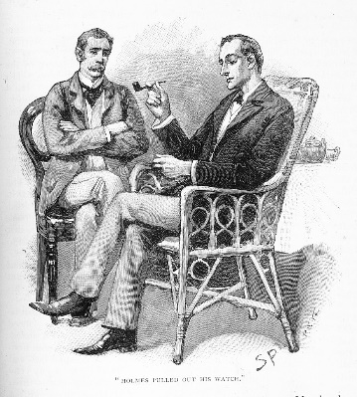
Watson can you get the teams to follow some instructions? OK then. Get them to write the name of a six sided polygon on a piece of paper, nominate one person to bring it and show it to the event coordinator, queuing silently, patiently and politely if others are there first and collect a puzzle pack.
Notes:
Start timing as soon as you show this slide. Only give a pack if one person from the team comes out and actually shows you the correct answer. Also, if the do not queue properly say “you must follow the instructions” and sent them back to their team. After five minutes, hand packs to any remaining teams and note who they were. Move to the next slide.

Slide 9
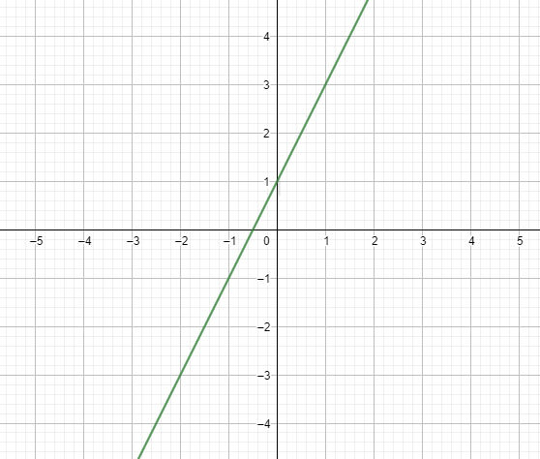
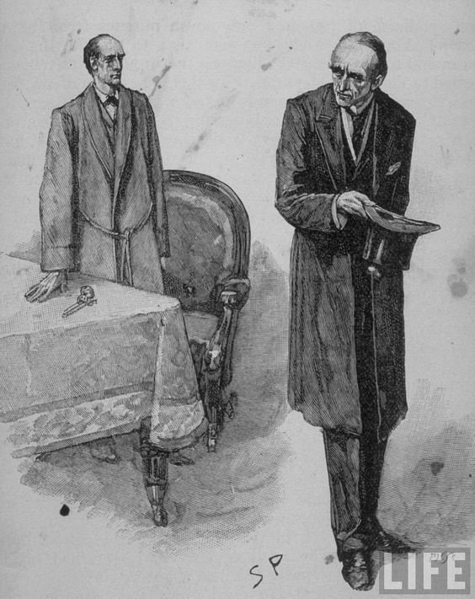
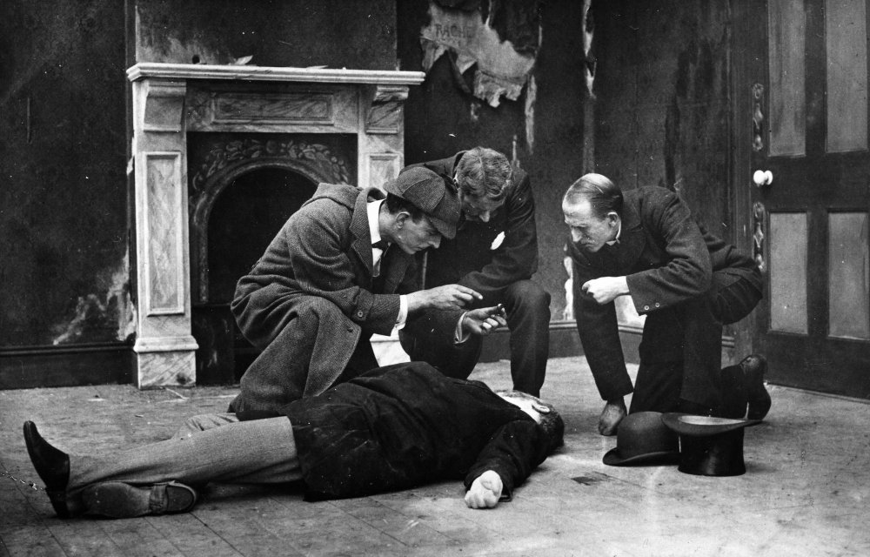
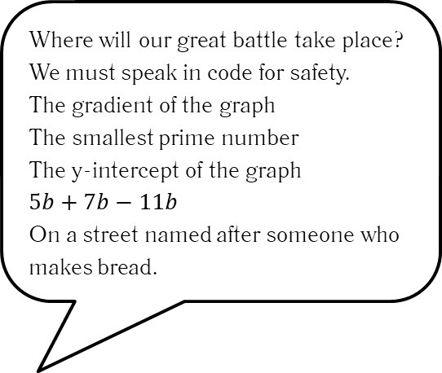
Where will our great battle take place?
We must speak in code for safety.
The gradient of the graph
The smallest prime number
The y-intercept of the graph
$$5b+7b−11b$$
On a street named after someone who makes bread.
Notes:
Show for ten minutes, give timing warnings then move onto the next slide.

Slide 10

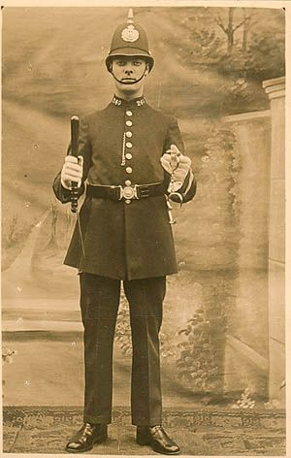
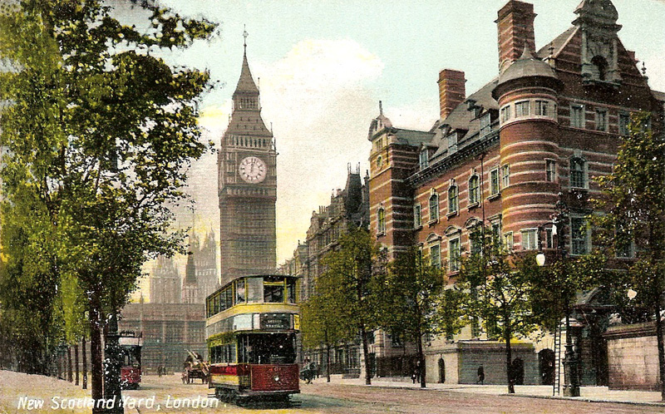
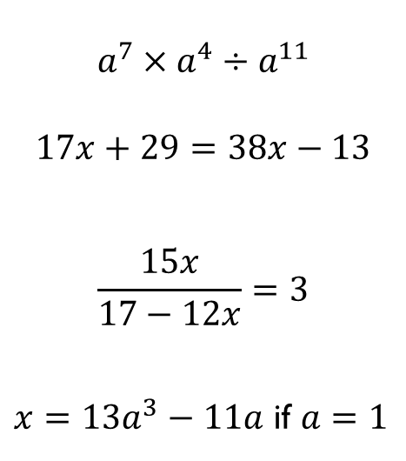
$$a^{7}×a^{4}÷a^{11}$$
$$17x+29=38x−13$$
$$\frac{15x}{17−12x}=3$$
$x=13a^{3}−11a$ if $a=1$
Time to ring Scotland Yard I think, Watson.
Now what is the number?
Notes:
Show for ten minutes, give timing warnings then move onto the next slide.

Slide 11
Hand in your answer sheet immediately!
Notes:
Collect answer sheets immediately. Give a 10 point penalty to any team for an undue delay.

Slide 12


COUNT ON US SECONDARY SCHOOL TOURNAMENT

