Slide 1
The Jack Petchey Spark Programme a self-discovery programme for young people
Discover how to be at your best more of the time!
Session 1: Mindset Matters

Slide 2
Welcome to the
Jack Petchey Spark Programme!
The Spark Programme is about helping you to Be At Your Best more of the time. Whether that’s feeling energised and motivated to pursue the goals that matter to you, managing to stay resourceful when life feels stressful, or being able to let your true personality shine through and bounce back when the going gets tough, the programme will give you some simple tools that you can practise and make use of while you’re at home under lockdown and in the future.
We will be sharing some powerful ideas and tools that have helped leaders in many of the world’s top companies, to become more effective and successful - leaders in companies such as Facebook, Samsung, BP, HSBC and McDonalds, as well as hundreds of teachers and school leaders. But like anything, these tools will only work for you if you give them a go and keep practising!
There are ten Spark Programme sessions for you to work through. We recommend following these in order from 1 to 10, but feel free to revisit earlier sessions to remind yourself of key ideas
Each session pack should take you around 30-40 minutes to complete.
Write down your answers to the reflection questions – using the PowerPoint files or a printout of the PDFs
Find opportunities to put your learning into practice. These are tools to use every day!
Let us know how you get on. You can message us on Twitter @BTSSparkUK – please tag #JPSpark or email us at spark.uk@bts.com We’d love to hear from you!
The BTS Spark Team
About the Jack Petchey Foundation
Sir Jack Petchey CBE created the Jack Petchey Foundation to recognise the amazing contributions young people make to society.
To do this the Foundation has invested £124 million in programmes that benefit young people aged 11-25 across London and Essex. The Foundation supports a wide variety of schemes in areas ranging from sport to science, art to internships, vlogging to volunteering.
The Foundation’s major programme is the Jack Petchey Achievement Award scheme, which operates in 1,600 grassroots youth clubs, youth organisations and secondary schools, Each young winner can choose how best to spend a £250 grant to benefit their organisation or school.
www.jackpetcheyfoundation.org.uk/
About BTS Spark
BTS Spark is part of a global company called BTS, which enables many of the world’s top companies to be more successful by helping their leaders do their best work of their lives! BTS Spark is the not-for-profit part of BTS and works with schools across the UK and in Australia and the United States. Most of our work is about helping teachers, senior leaders and head teachers to develop their leadership, but we also support young people to build their personal resourcefulness and agency.
www.bts.com/spark
3

Slide 3
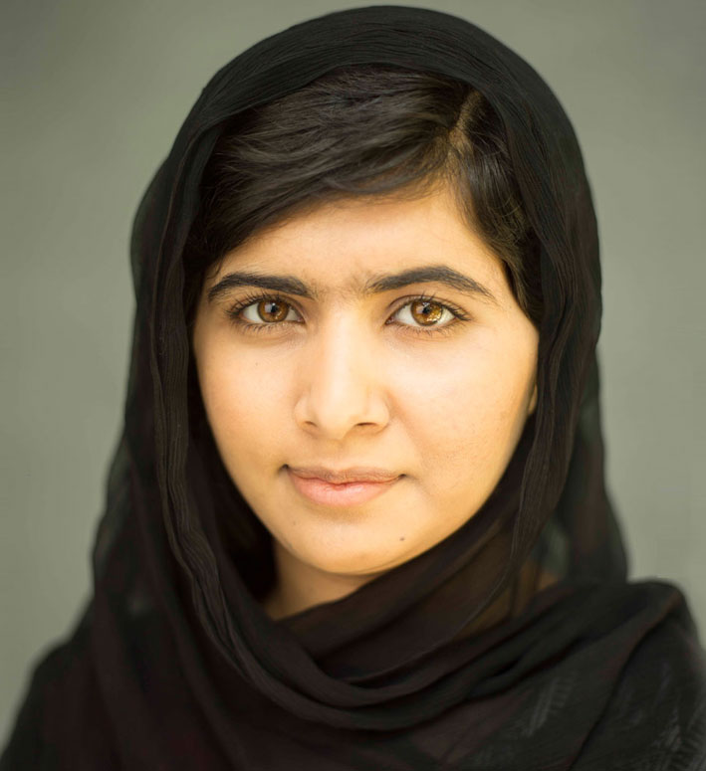
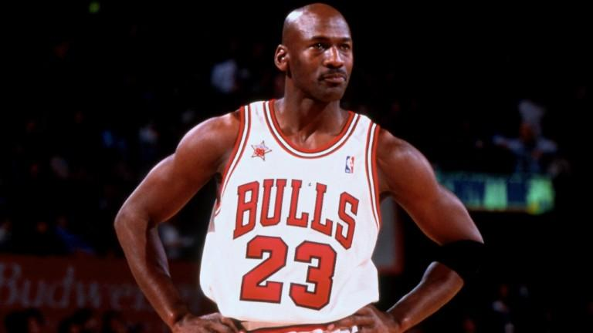
Mindset matters
Understanding mindset and why it matters is at the heart of the Spark Programme. By Mindset we mean our way of thinking, our attitudes and our beliefs about the world. These influence how we behave, how we communicate and how we deal with challenges and opportunities. Our mindsets can help us to Be At Our Best or they can hold us back from achieving our potential.
Malala Yousafzai, student and activist
Malala believes that every girl has the right to be educated, regardless of their religion or social standing. Malala grew up in Pakistan and campaigned publicly about girls’ right to education when she was still a school student.
This made her a target for the Taliban and she was shot in the head aged just 15. She now lives in the UK, studies at the University of Oxford and still campaigns globally. Her love of learning (which is a key part of a growth mindset) is so strong that she risked her life in Pakistan to stand up for what she believed in.
About Sir Jack Petchey CBE
Sir Jack was born into a working class family in 1925 and left school at 13 without any qualifications. He joined the Navy’s Fleet Air Arm in 1943 but was unsuccessful when applying for officer training. After leaving the Navy he began working as a clerk for the Solicitor’s Law Stationary Society. He applied for management training but was told he would never make a businessman!
Instead of giving up, Sir Jack used the £39 he was given when discharged from the Navy to buy a second hand car and start a taxi business. Through hard work, he went on to build successful business ventures ranging from cars to property, and to set up the Jack Petchey Foundation.
Having a positive mindset is incredibly important to Sir Jack and he believes that this has helped him develop as a better person.
He believes that every person is unique - your DNA, the way you are, your gifts, your talents and your experiences are all specific to you. No one else will ever walk, talk, think or do things exactly as you do. This is magic! Don’t spend your life wishing you were someone else, live your life to the full and enjoy being who you are. Sir Jack wants us all to remember his motto
“If you think you can, you can!”.
Learn more about Sir Jack and the work of his Foundation by watching this video.
Go Do!
What messages about mindset do you hear?
Michael Jordan, basketball player
When Michael didn’t make the college basketball try-outs his mother told him that he simply had to work harder. He worked hard, harder than the rest of his team, harder than most athletes and went on to become the greatest basketball player of all time. He continued to get better throughout his career, always giving his opponents a new challenge - "my attitude is that if you push me towards something that you think is a weakness, then I will turn that perceived weakness into a strength." He worked his way to greatness with his growth mindset telling him that anything is possible if you try hard enough.

Slide 4
Fixed and growth mindsets
Did you know?
Professor Carol Dweck studied the behavior of thousands of young people to understand how their mindset affects their learning.
She found that those students that think their skills and talents are fixed and can’t change, may learn less or learn at a slower rate. Those that see that their talents and skills take time, effort and practice to master, are often faster at learning and enjoy it more.
They deal with challenges as opportunities to improve their skills. These students have a Growth Mindset.
Watch this fun video to understand how your brain enables you to learn.
Growth Mindset
Fixed Mindset
I can learn anything I want to
When I’m frustrated, I persevere
I want to challenge myself
When I fail, I learn
If you succeed, I’m inspired
My effort and attitude determine everything
I’m either good at it or I’m not
When I’m frustrated, I give up
I don’t like to be challenged
When I fail, I’m no good
If you succeed, I feel threatened
My abilities determine everything
Created by Reid Wilson
Exercise: Exploring my mindsets
Most of us hold both fixed and growth mindsets. For example, we might think we can improve at sport, but are no good at music (or vice versa). Fill in the boxes below with your own examples:
Fixed Mindset
Eg. ‘I can never keep my notes organised’ or
‘This is so easy. I’m good at maths’
1.
2.
3.
Growth Mindset
Eg. ‘I’m going to practise my French so I get better’
or ‘I’d like to learn that skill’
1.
2.
3.
Key Insights
Mindset is a way of thinking and set of beliefs that shape the way we handle situations
A fixed mindset assumes our skills and abilities cannot change. This mindset can lead to us avoid challenges and give up easily, so we may not learn and improve.
A growth mindset helps us to learn and achieve our potential
Surprise yourself! Write a lockdown bucket list. Identify at least three things you can’t do YET, that can be done at home or within the current guidelines for outdoor activities. It might be cooking a specific meal, achieving an exercise goal, or learning a new skill. Over the next two weeks, your challenge is to have a go and practise at least one of these activities at least three times. What do you discover? Was it easier or harder than you expected? What are the next steps you will take to build on this experience?
Go Do!

