Slide 1
The Jack Petchey Spark Programme a self-discovery programme for young people
Discover how to be at your best more of the time!
Session 2: Being at my best

Slide 2
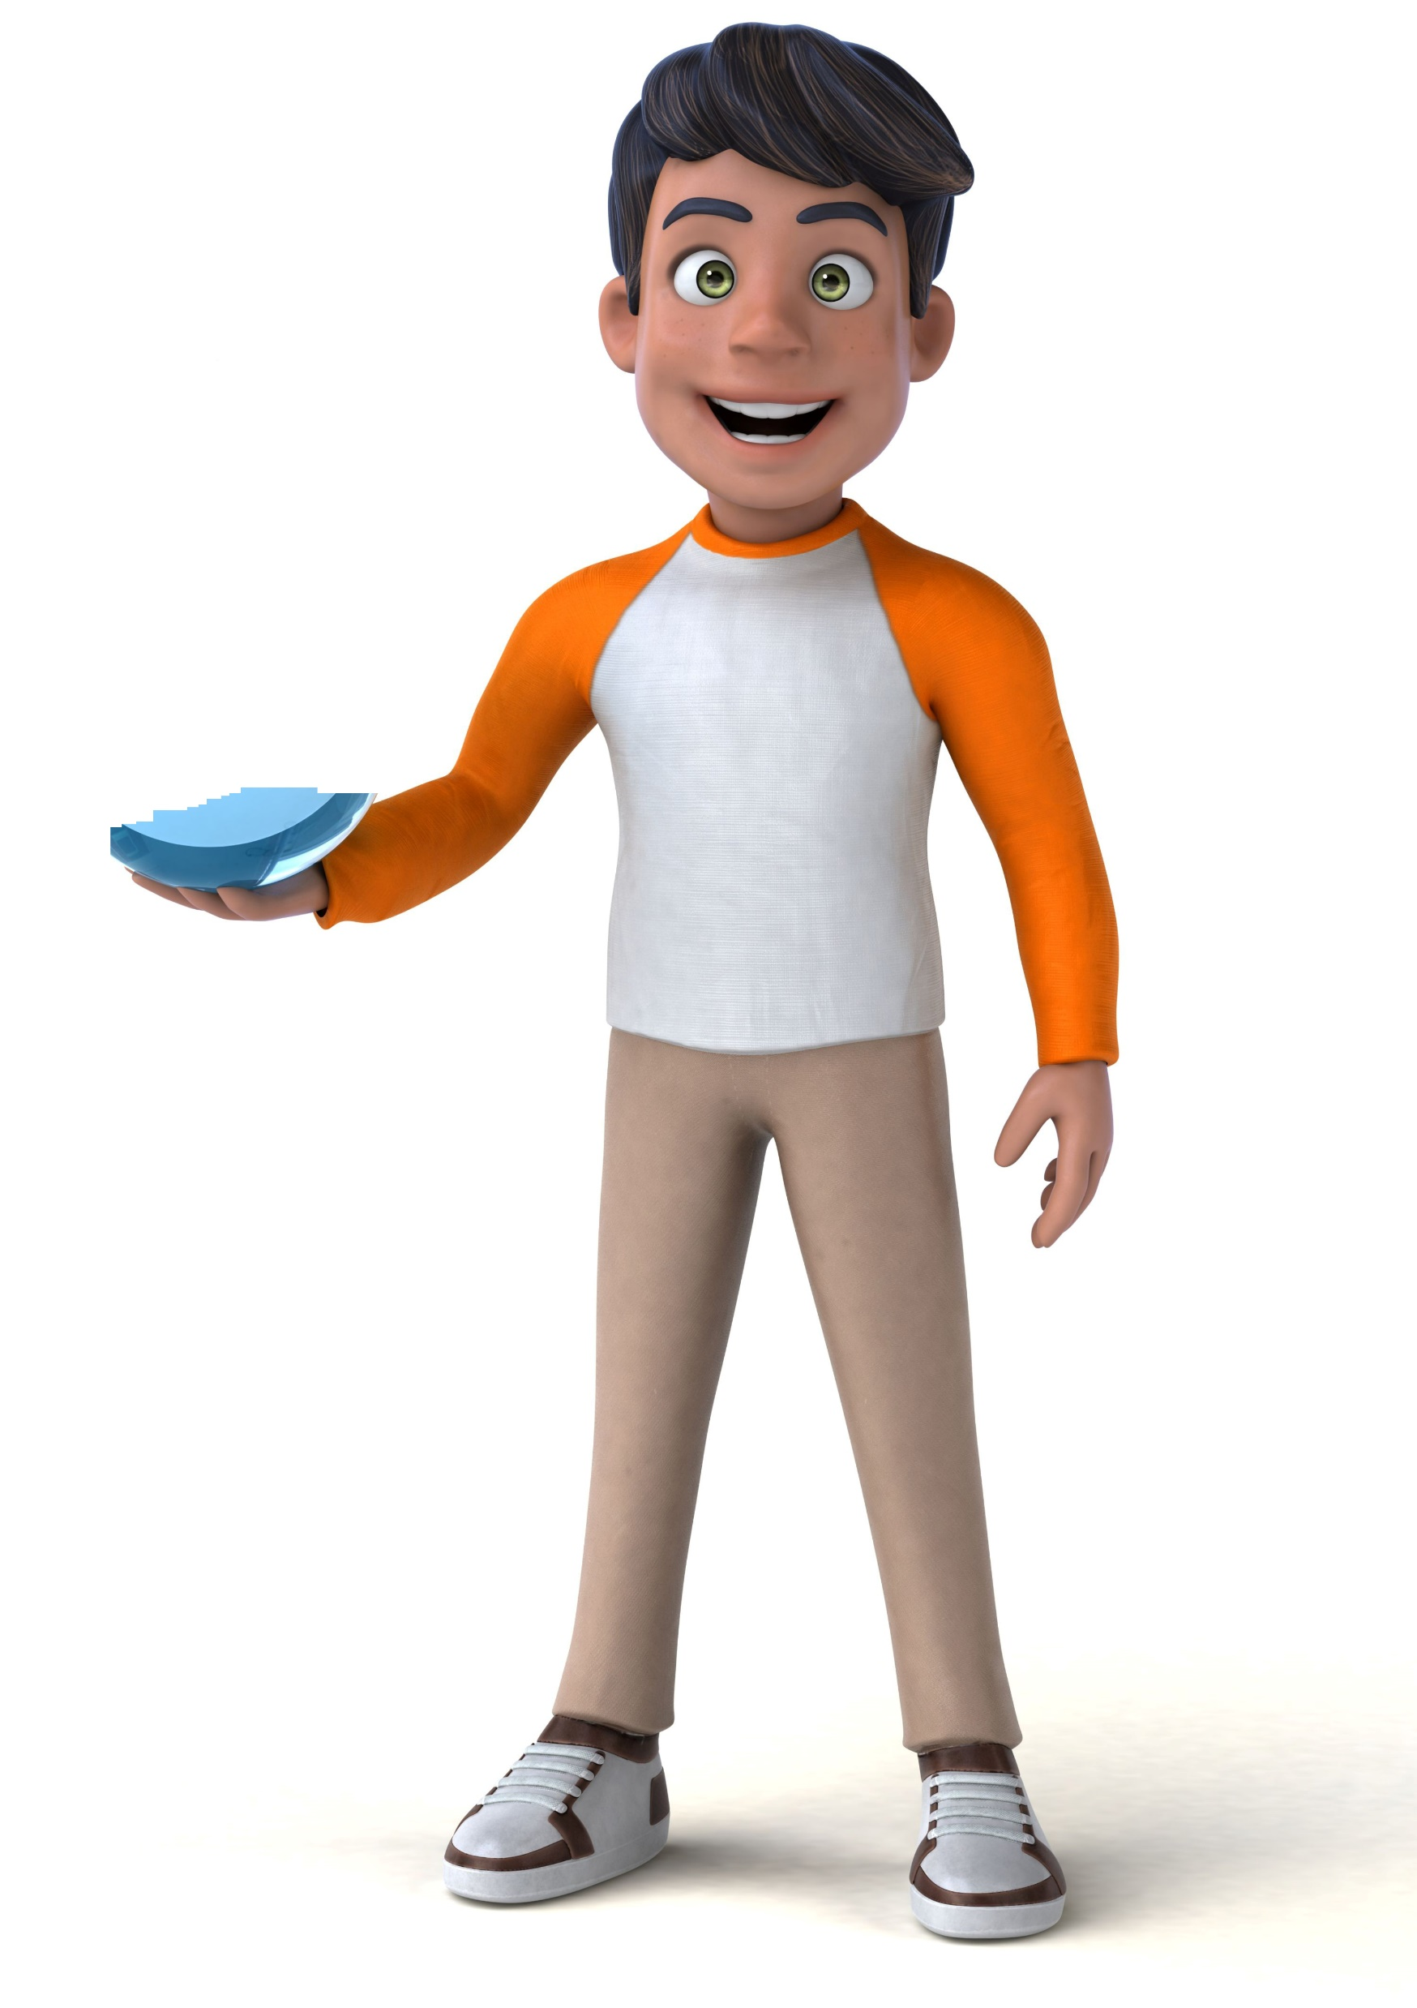
In and Out of the Box
At BTS Spark, we use a simple metaphor of being In or Out of the Box to describe two different states or ways of being - Being At Our Best or Not At Our Best.
When we are Out of the Box, we can be At Our Best. When we are Out of The Box, we will be more resourceful, better able to solve problems and find different ways to achieve our goals. When we are In the Box, we will Not Be At Our Best.
Exercise: When I’m At My Best (Out of the Box)
What are you like when you are at your best and feeling confident and capable? How do you feel? What do you think? Write down as many words as you can to describe what this is like:
OUT
of the
BOX
My Spark Moment (when I was Out of The Box)
Now think of a specific time when you were Out of the Box and felt fantastic! Imagine being back in that moment right now. Describe the situation and note down your thoughts, feelings and behaviours. Describe what the results were (for you or for others).
Thoughts
Feelings
Situation
Sum up your Spark Moment in this box with a picture, symbol or description that will remind you of that moment:
Behaviours
Results
We’ll come back to your Spark Moment later in the programme.
Results

Slide 3
Our experience of being In or Out of the Box is made up of a mix of thoughts and feelings. Our feelings will include emotions and bodily sensations, such as hot, cold, sweaty or relaxed.
How good are you at noticing your feelings? Common feelings include:
Sad | Creative | Bored | Proud | Excited | Angry | Appreciated
Confused | Happy | Helpless | Insecure | Confident | Hurt | Energetic
Cheerful | Lonely | Hopeful | Tired | Respected | Afraid | Calm
Content | Thoughtful | Trusting | Surprised | Anxious | Thankful | Rejected
Exercise: When I’m Not At My Best (In the Box)
What are you like when you are Not At Your
Best (In the Box)? What do you think? How do you feel and behave?
An In the Box experience
Now think of a specific time recently when you were In the Box. Note down your thoughts, feelings and behaviours (what you did). What were the results?
IN the BOX
Situation
Did you know?
Most of the time we don’t notice our thoughts. They go on in the background, helping us make decisions and carry out many tasks automatically. These automatic thoughts affect our feelings and behaviours without us even realising they do. Some experts believe we have up to 50,000 thoughts a day!
Thoughts
Key Insights
We all have two different states of being – being At Our Best and Not At Our Best
When we are In the Box typical feelings are worried, uncertain, bored, annoyed, unmotivated or angry
When we are Out of the Box, typical feelings are clear, calm, confident, excited, motivated, relaxed, positive and energetic
Being In the Box is completely normal. Nobody is at their best all the time, in fact many of us are In the Box most of the time!
Feelings
Behaviours
Look out for those times that you’re In the Box. The best way to tell is to notice how you are feeling. Try changing your state by moving somewhere else, doing some exercise, or choosing to do something you enjoy. Write a list of your In the Box situations and see if you can notice any patterns.
Go Do!
Results
In our next Spark Programme sessions, discover WHY we go In the Box and learn some tools to help you get out!

