Slide 1
The Jack Petchey Spark Programme a self-discovery programme for young people
Discover how to be at your best more of the time!
Session 3:
Understanding my triggers

Slide 2
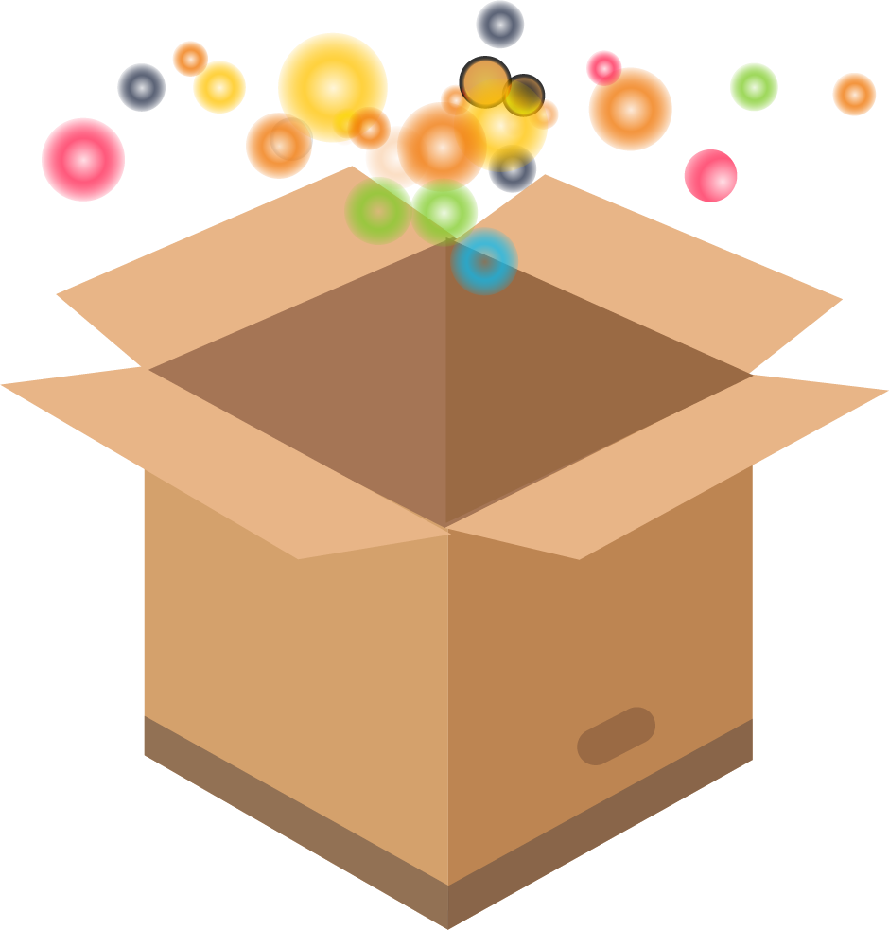
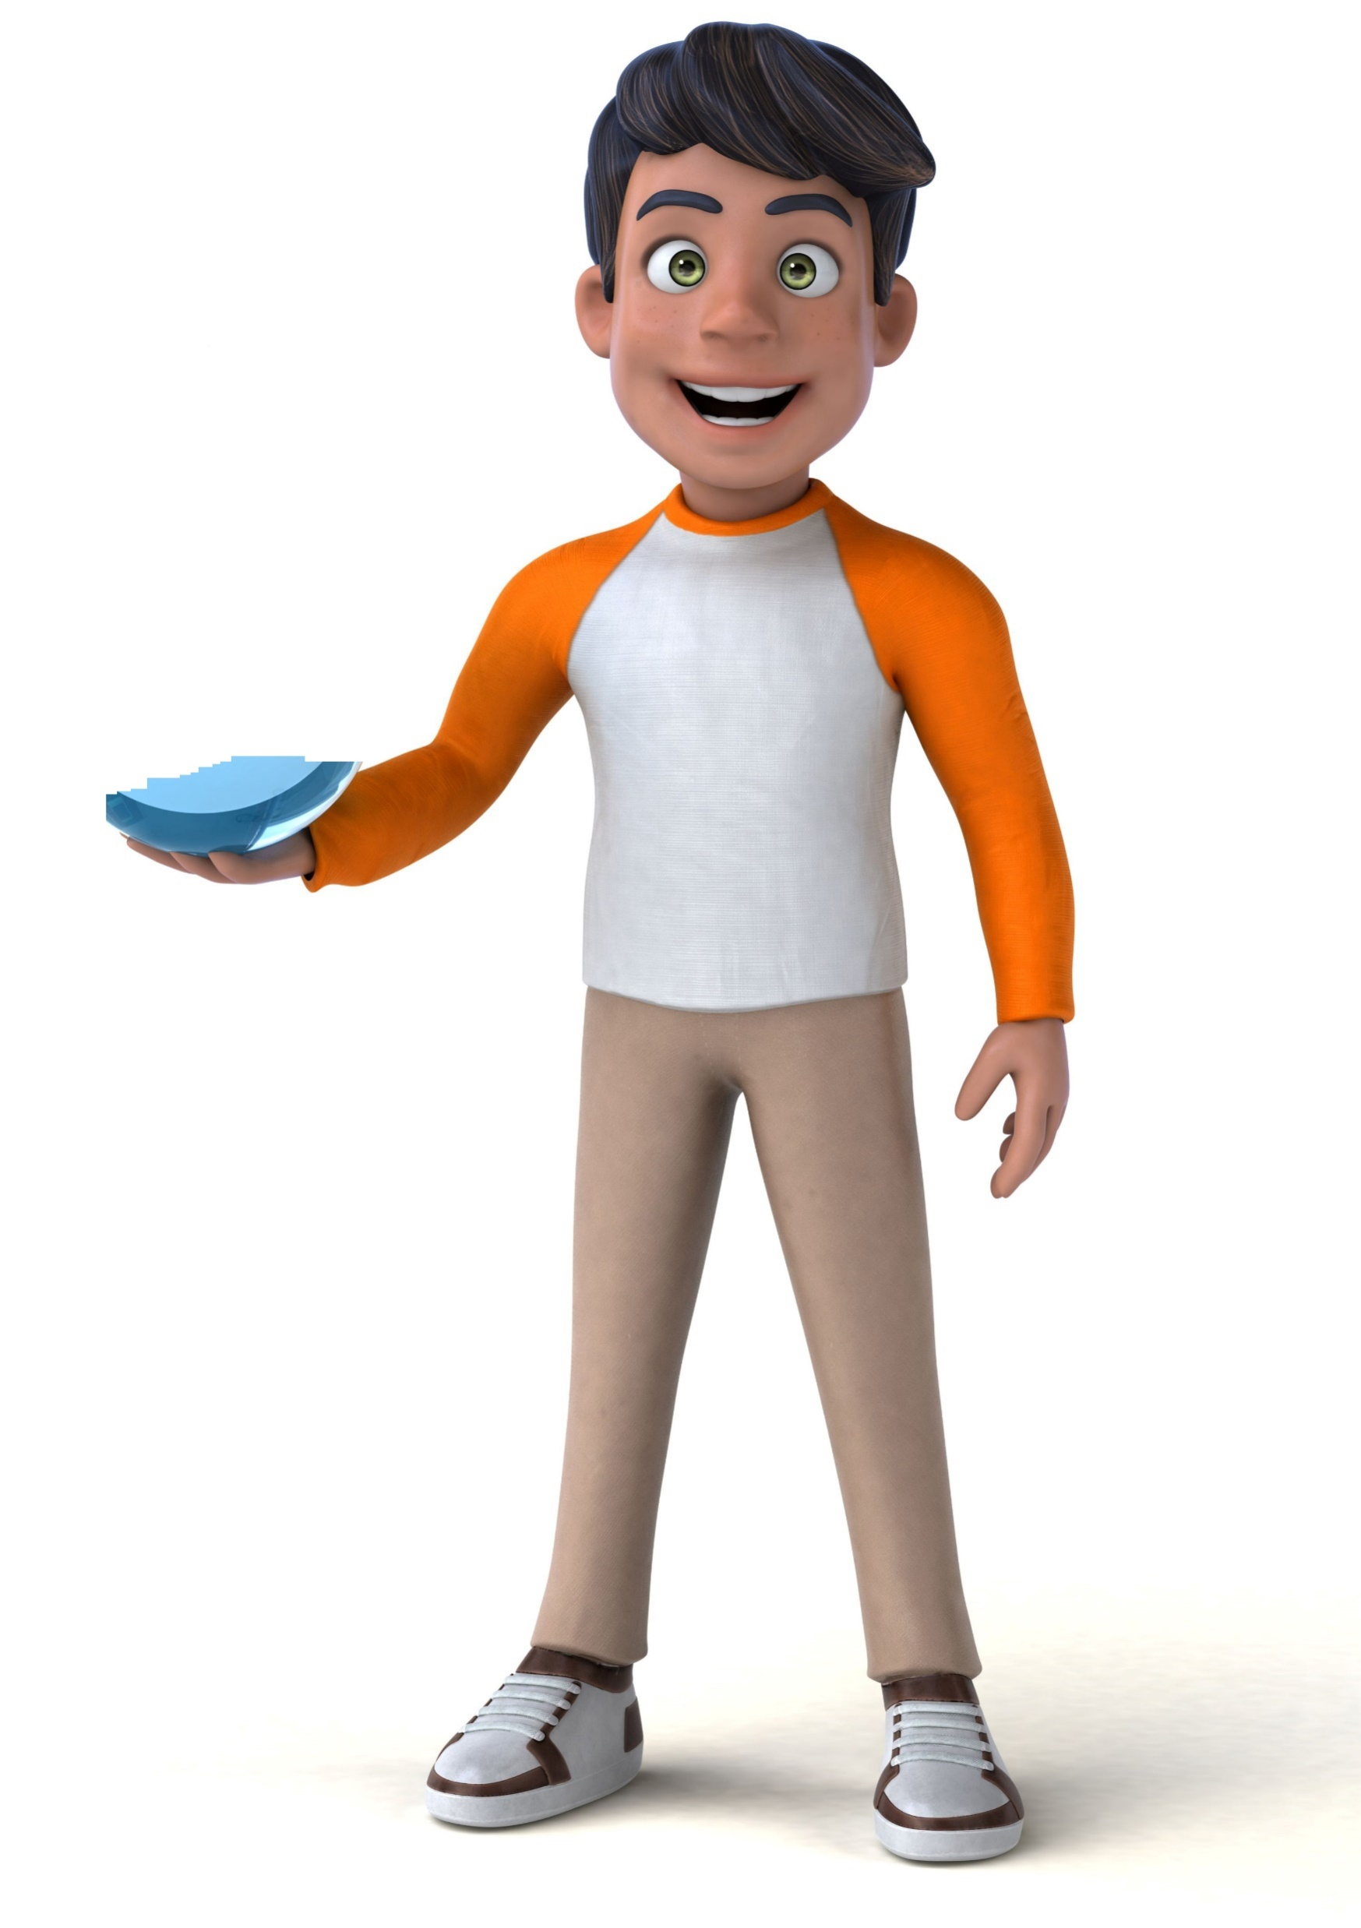
Triggers
In the last session, we used the metaphor of Being In and Out of the Box, to describe two states of being – Being At Our Best (Out of the Box) and Not Being At Our Best (In the Box).
Your ‘Go Do’ was to notice when you are In the Box and look for any patterns in these situations. How did you get on? Did you notice any particular events that seem to be linked to you going In the Box? We call these events triggers.
OUT
of the
BOX
Triggers are experiences or events, big or small, that we encounter from the outside world or from our own mind. Triggers may lead to us going In the Box (depending how we respond to them). We all experience many triggers every day. A trigger may last just a split-second! Some experiences or thoughts might be a regular trigger. Others might trigger us sometimes, but not always, depending on our mood or mindset at the time.
ITV’s I’m a Celebrity Get Me Out of Here, or any reality show, is always full of triggers and examples of In the Box feelings and behaviours. Have a watch of this encounter between contestant Helen Flanagan and an ostrich, and see if you can spot the trigger that precedes her In the Box reaction! Watch here.
Exercise: Explore your triggers
Which of the following events or experiences tend to be a trigger for you? Tick those that are relevant for you. Add some more examples at the bottom that are common trigger events for you. Try and be as specific as possible!
Your teacher gives you a complicated piece of homework when you already have lots to do
You read a negative comment on your social media post
Your mum tells you to do a chore that you were just about to do anyway
A few people laugh at a question you have asked in class
A teacher tells you to be quiet
You see a picture on Instagram of a friend at a party that you weren’t invited to
A parent says “Sit down. We need to talk about your grades.”
You overhear a friend blaming you for something you haven’t done
A teacher leans over your shoulder to check your work
Notes:
https://vimeo.com/341803852/a0e02b2e22

Slide 3
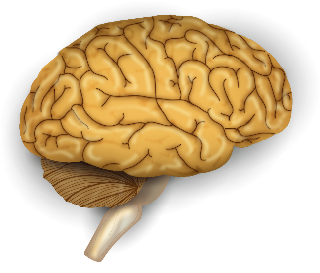
The fight, flight or freeze response
What happens when we react to a trigger? This is well illustrated by our natural Fight, Flight or Freeze Response. This is thought to be a response that evolved to protect our ancestors from danger. However, there are many times today when our bodies over-react and exhibit the Fight, Flight or Freeze Response in situations that are not life-threatening, such as being stuck in a traffic jam, worrying about an exam, or having a disagreement with a friend.
Did you know?
The amygdala is the part of your brain that is responsible for processing memory, decision making and emotional responses, especially fear. It is like an alarm bell in your brain, always checking to see if you are safe.
When your brain detects a threat and you feel worried, stressed or scared, it turns on the alarm and starts a chain reaction which floods your body with adrenaline and cortisol. These hormones make it hard to think clearly and send you into a fight, flight or freeze response.
The adrenaline causes your heart rate to increase to carry more oxygen around your body, and the cortisol raises glucose levels in your blood to give you more energy, so you are ready to take on the threat (fight) or run away from the threat (flight).
The freeze response happens when your brain decides it can’t fight the threat or run from the threat, so your body dissociates itself from what is happening by freezing.
Amygdala
Prefrontal cortex
Thoughts
FIGHT
FLIGHT
FREEZE
Feelings
Behaviour
Key Insights
We all experience trigger events every day – this is completely normal! They can happen in a split second!
Our natural Fight, Flight or Freeze reaction can kick in and we end up In the Box and not at our best. In this state we are likely to over-react and behave in an unhelpful way.
But, it is NOT actually the trigger itself that puts us In the Box. It is our own thoughts! We can tell that this is true because the same trigger event does not always lead to the same reaction!
Results
See how many trigger events you can spot! Try and identify the specific event, thing someone said, or thought that you had, that triggered you. Keep a daily log and see how many you notice.
Go Do!

