Slide 1
The Jack Petchey Spark Programme a self-discovery programme for young people
Discover how to be at your best more of the time!
Session 5:
Bouncing back!

Slide 2
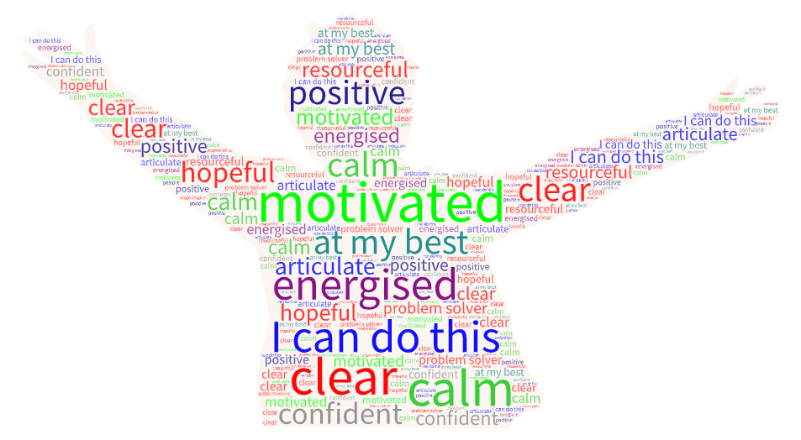
Be a state shifter!
Through the Spark Programme so far, we have explored two different states of being – Being at Our Best (Out of the Box) and Not Being At Our Best (In the Box). We have looked at triggers – specific events or experiences that can lead to a chain reaction of In the Box thoughts, feelings and behaviours. We’ve seen how our In the Box thoughts are often the exaggerated and overly dramatic voices of our internal Judge and Pessimist and how these contrast with the balanced, truthful voice of our Realist. Our Realist is the wise part of ourselves that helps us to be at our best and to be resourceful and resilient.
In this session and the next one we will look at how you can shift your state and bounce back from an unresourceful In the Box state to a resourceful Out of the Box state. There are lots of ways you can do this. The more strategies you can find that work for you, the better!
Resourceful – three dictionary definitions:
Having the ability to find quick and clever ways to overcome difficulties
Able to deal skillfully and promptly with new situations, difficulties etc
Skilled at solving problems and making decisions on your own
Why is this important?
Growing up today is challenging and young people face lots of pressures – from school, parents, friends, social media, and society more generally. The chances are that you will feel the pressure from many different directions and have a lot of juggling to do as you try to balance increasing levels of school work, spending time with your friends and family, developing your own interests and skills, maintaining a healthy lifestyle, and starting to think about your future pathways and career options. As you grow older and are given opportunities for more independence, the choices you face can seem complicated and sometimes tricky to navigate.
Learning how to build and regain your personal resourcefulness and how you can Be at Your Best more of the time by applying the tools and ideas that we introduce you to through the Spark Programme, can make a big difference to how you experience the challenges of your secondary school years. In fact, they are truly tools for life! They will help you to manage your own mindset, how you respond and deal with difficult and high pressure situations, and how you identify and consider the choices available to you.
Exercise: My existing state shifting strategies
What strategies do you use already to help you relax and feel more resourceful when you’re feeling stressed or anxious? Note them down here:
Create your own word cloud for how you feel when you’re At your Best. Print it out and stick it on the wall, or use it as your wallpaper on your phone or laptop to inspire and remind you this is the state you are aiming for. www.wordart.com
Go Do!

Slide 3
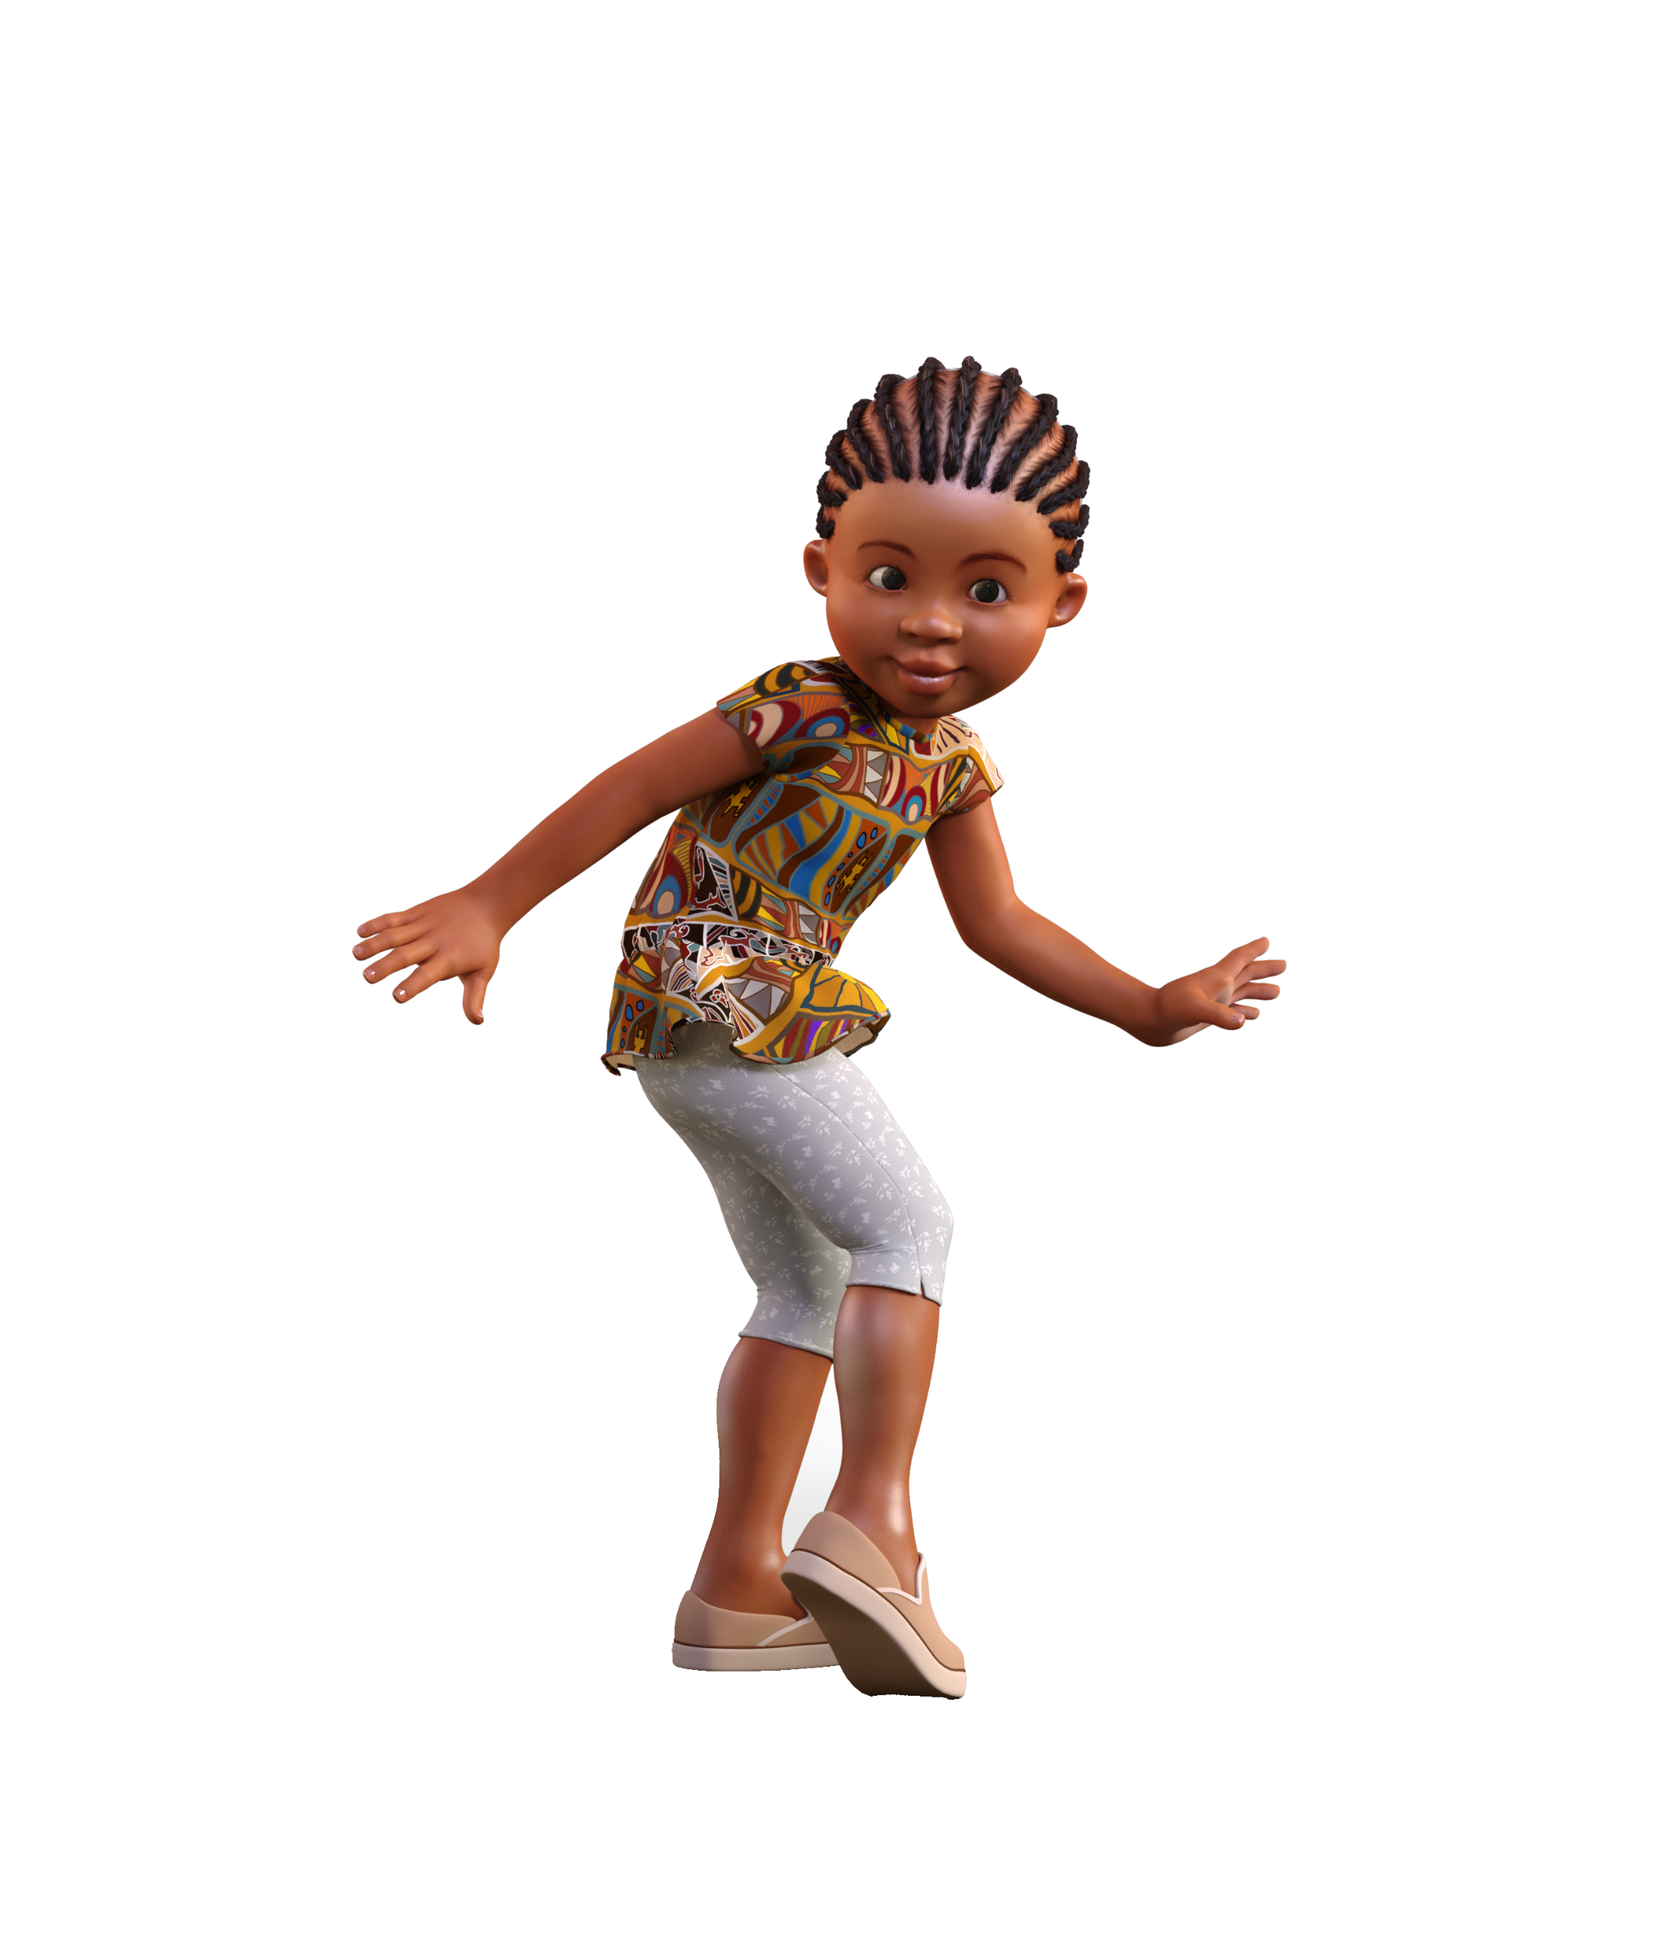
Tips for bouncing back
To get Out of the Box, we need to change our state – our thoughts and feelings. Here are some ways in which we can do this.
MAKE A PHYSICAL CHANGE
Our feelings occur in our body, so making physical changes can help us change our feelings and our state.
Take a break / slow down / count to ten / take a few deep breaths.
Change your physical state / be active (exercise is a great way to change your state – but even just moving around can help).
Build your physical resilience – especially during demanding times such as revision and exam periods. We are much more likely to be triggered when we are tired, not eating healthily or lacking in exercise.
FOCUS ON SOMETHING POSITIVE
Often spending time getting clear on what we want (rather than on our fears) helps us to re- discover a more balanced perspective.
Remind yourself of your goals and aspirations – what are the small steps you can take now to help you make progress? Write down the actions you will take this week and next week. Tick them off and add your next steps.
Remind yourself of what is really important to you – make a plan to focus some time and energy on this.
SPEND TIME WITH PEOPLE
You can only listen to one thing at a time – either your own self-talk or to other people. Focusing on others can also restore balance.
Share your thoughts and feelings with a trusted friend, teacher or family member and ask for their advice. Listen carefully to their reflections and suggestions.
Spend time with your friends or family.
Volunteer – helping others, in a small way at home, or through a regular commitment to a local project, can feel really satisfying.
WORK ON OUR THOUGHTS
These are the most powerful tools because they can change the self-talk that puts us In the Box in the first place.
Begin to notice your patterns – what are the types of triggers that lead to you going In the Box? What themes do you notice? Decide in advance how you want to be if you are triggered. The more you notice or anticipate the triggers, the more likely you are to be able to respond differently .
Learn and put into practice the BTS Spark Check-Challenge-Choice process (see Session 6 for this).
Meditation and Mindfulness – these can help you become more aware of your thoughts and emotions, and help you to feel more relaxed. Find useful guides and exercises on YouTube or at www.mindful.org/meditation/mindfulness-getting-started.

Slide 4
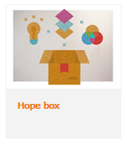
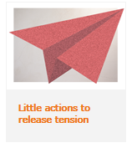
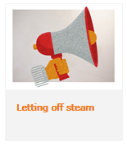
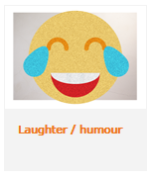
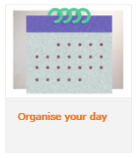
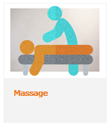
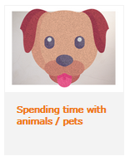
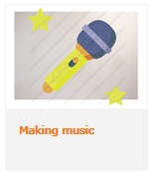
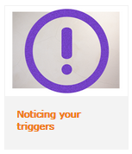
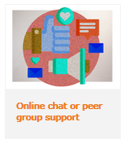
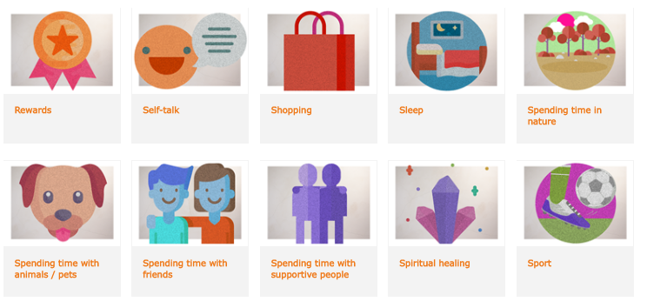
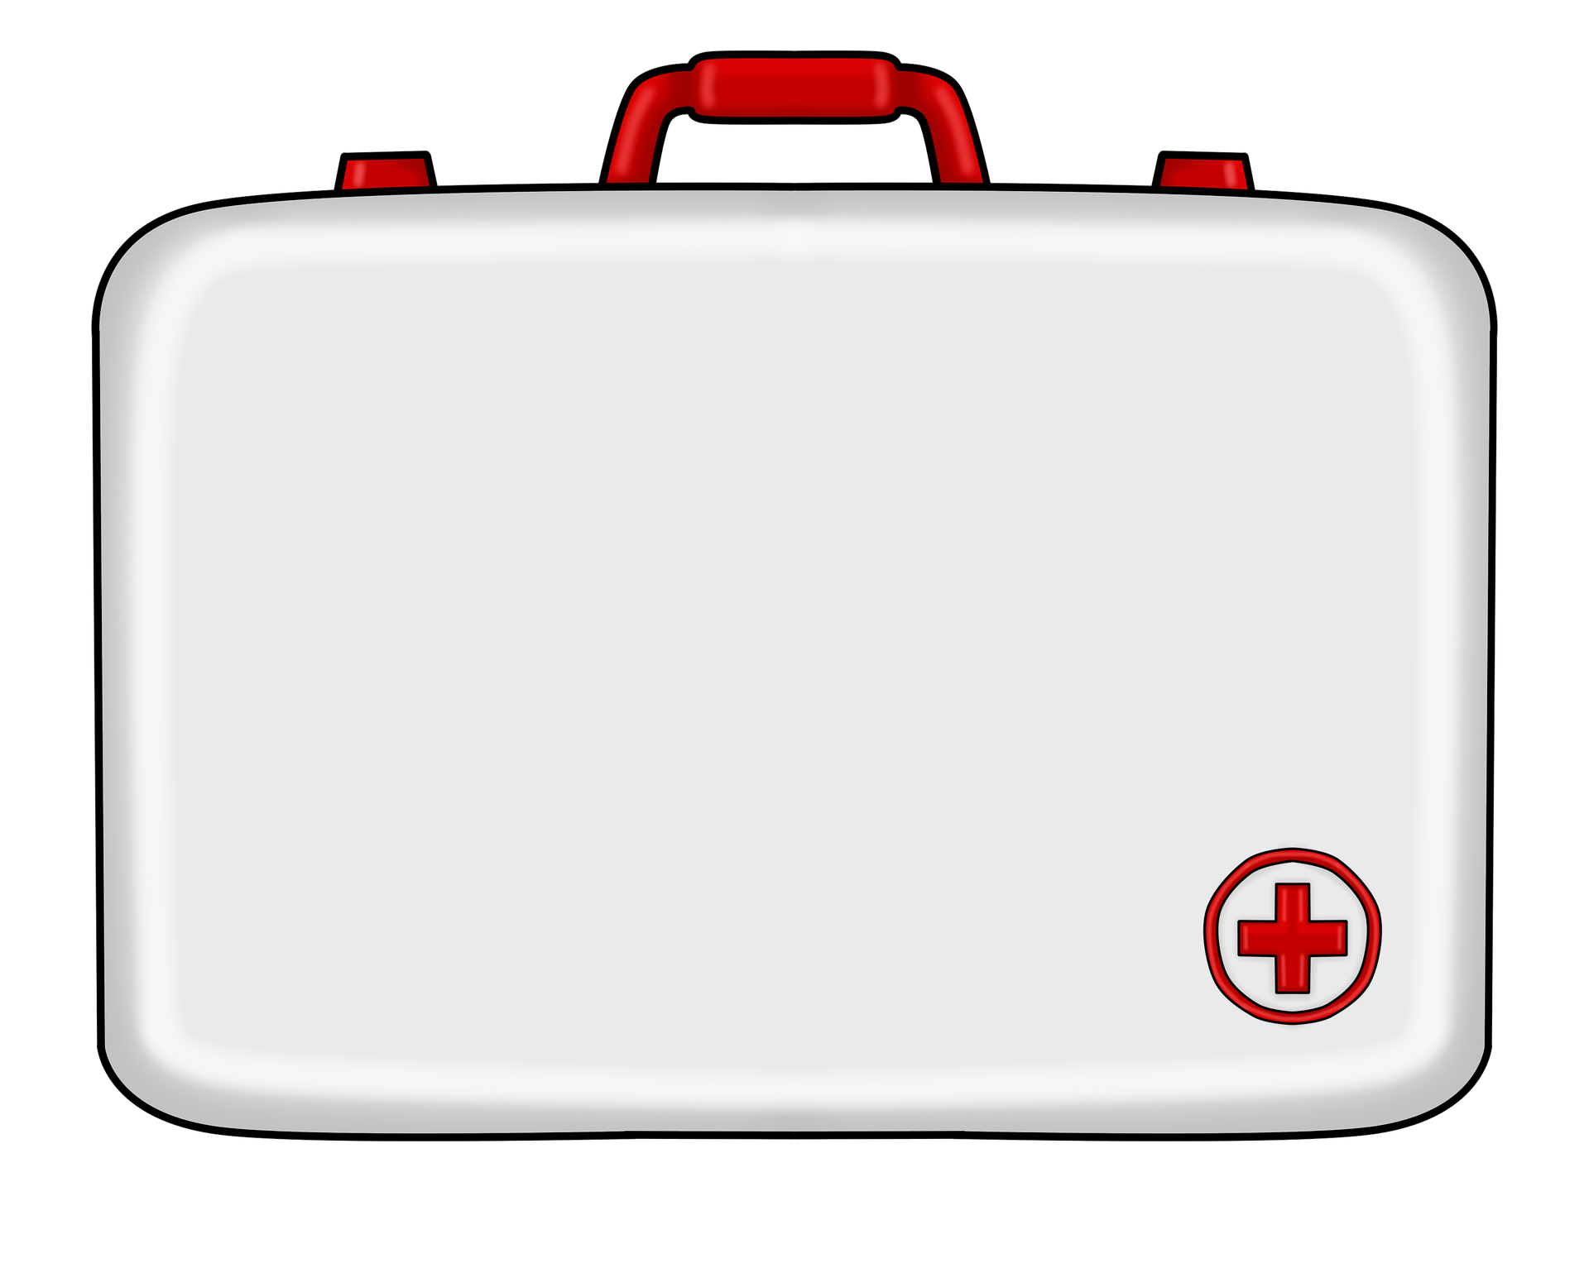
Boost your self-care toolkit
Were you able to identify some strategies that you already use to help you relax and regain your resourcefulness? There are many more that you could try. We recommend having a look at the A-Z of self-care ideas at www.annafreud.org/on-my-mind/self-care. Have a look now and see if you can find ten new ways that you can use to shift your state when needed.
New ideas for my self-care toolkit:
1.
2.
3.
4.
5.
6.
7.
8.
9.
10.
WHEN YOU NEED HELP
We all need help at times. If you are finding it difficult to cope with worries and pressures, try and talk to a parent, carer or trusted adult. If that is not possible, the following organisations have someone available 24 hours a day, seven days a week:
Childline www.childline.org.uk Tel. 0800 1111 The Samaritans – www.samaritans.org Tel. 116 123
More helpful ideas and sources of support are available from www.themix.org.uk; www.annafreud.org/on-my-mind; www.youngminds.org.uk; www.anxietyuk.org.uk
Create your own Self-Care First Aid Kit. This is a box you can keep at home containing things that will help you when you’re feeling stressed or
Go Do!
anxious – for example pens and paper if you like to write or draw, pictures or objects that remind you of special times, bubble bath, chocolate, a list of people you could call, a reminder of a special playlist, a stress or fidget toy etc.
Key Insights
Growing up today is challenging. Life can be tough! All of us will face difficult situations and choices, as well as the many everyday triggers that can result in us going In the Box.
To help us get Out of the Box and regain our resourcefulness so we can see things more clearly and make the most helpful choices, we need to change our state.
There are lots of ways to do this, including making a physical change, focusing on something positive, spending time with people and working on our thoughts. It’s good to identify our own self-care toolkit of the strategies that work well for us so we know what to do when we need them.
Write your ideas here for what you’ll put in your Self-Care First Aid Kit:

