Slide 1
The Jack Petchey Spark Programme a self-discovery programme for young people
Discover how to be at your best more of the time!
Session 10: My Winning Formula

Slide 2
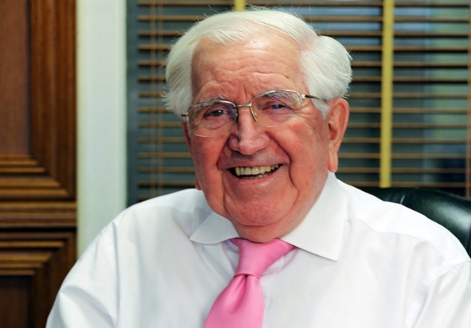
A Winning Formula
Well done for reaching this last step in the Jack Petchey self-discovery Spark Programme! As you know, the aim of the programme has been to help you to Be At Your Best more of the time. We have shared some tools and ideas that we hope will help you to:
feel energised and motivated to pursue the goals that matter to you
feel resourceful and able to make helpful choices when you’re under pressure
be able to bounce back from difficult and stressful situations
This final Spark Session is about recognising and helping you to sum up what you have learned so that you can get really clear on the insights and tools that you will continue to use going forward. We hope these will make up a new Winning Formula that you can use to help you Be At Your Best.
What do we mean by a Winning Formula?
Well, we all have one. A bit like an automatic pilot on a plane, it is made up of the ideas and decisions that we use, consciously or unconsciously, to guide our actions. Out mindset plays a big part in this. Our Winning Formula is based on what we believe will enable us to be successful and includes the ways we think about things, our intentions, the commitments we make and our actions. Have a look at these examples below, which illustrate aspects of Sir Jack Petchey’s winning formula and that of Olympic athlete, Jason Richardson:
Jason Richardson, World Champion 110m hurdler and 2012 Olympic silver medal winner
“To become an Olympian is a culmination of all the hard work t that goes into being a professional athlete. To be an Olympian is to dream while being awake!”
'I love the art of competing in and of itself. The individuality of track and field means you live and die by your own efforts. My passion for competing has been a major player in my success.“
"I try to keep myself calm before the athletic storm through music and light meditation.”
“Don’t fear your opponents, just respect them! We are all made of the same stuff!”
“No one is an island so surrounding yourself with good people can make the difference between winning and losing. My family is incredibly supportive, always in my corner and firm like stone. My coach and my training partners all contribute to a championship culture that makes winning commonplace.”
Sir Jack Petchey CBE
Hard work and a determined attitude – Sir Jack believes there is no room for missed opportunities. When he started his first business, a taxi company, he would sleep on the floor at his business premises so that he would never miss a customer’s call!
Life is a teacher – every experience can teach us a lesson. What we learn from the lesson is up to us. Learning from what went right, or wrong, in the past, can shape our successes in the future. It’s important to have a positive approach to finding solutions and Sir Jack believes this is what has helped him build a successful career and lead a happy, fulfilled life.
Think positively – “If you think you can, you can!” – after being told as a young man that he was not management material, Sir Jack set himself the goal of being his own manager, and he succeeded.
It is our Winning Formula that influences many of our decisions and choices. In many ways it sets the priorities and determines the patterns that we live by. Obviously, we would all like our Winning Formulas to consistently help us to win in life. Unfortunately though, our automatic pilots have bugs and glitches in them. Often our Mindtraps, for example, or our Pessimist and Judge self-talk, corrupt our Winning Formulas so that when we follow them, the results are not what we would want.
Hopefully the Spark Programme has helped you to see what some of your bugs and glitches might be, and you are now ready to create a New Winning Formula that can guide you and help you to achieve the results you want in life.

Slide 3
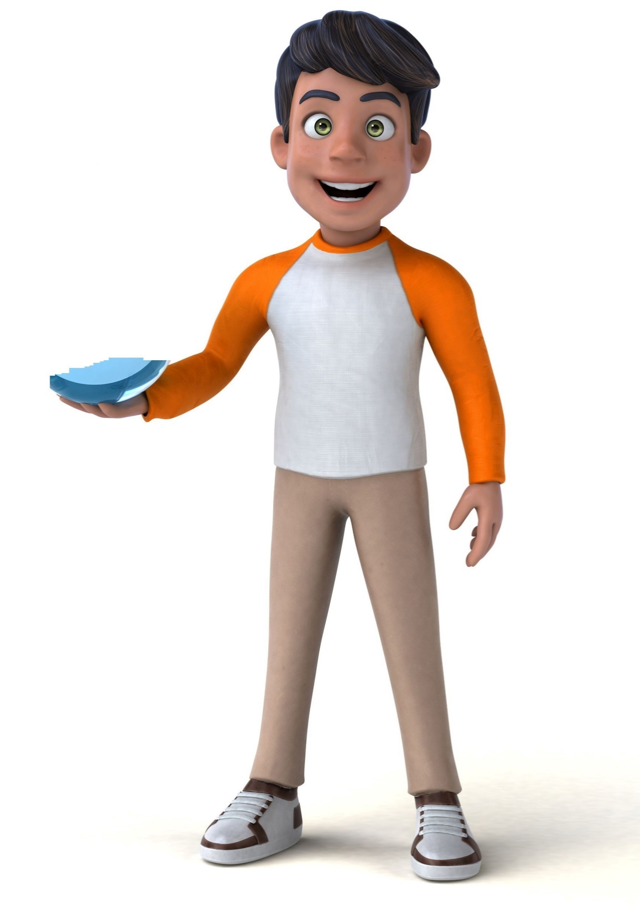
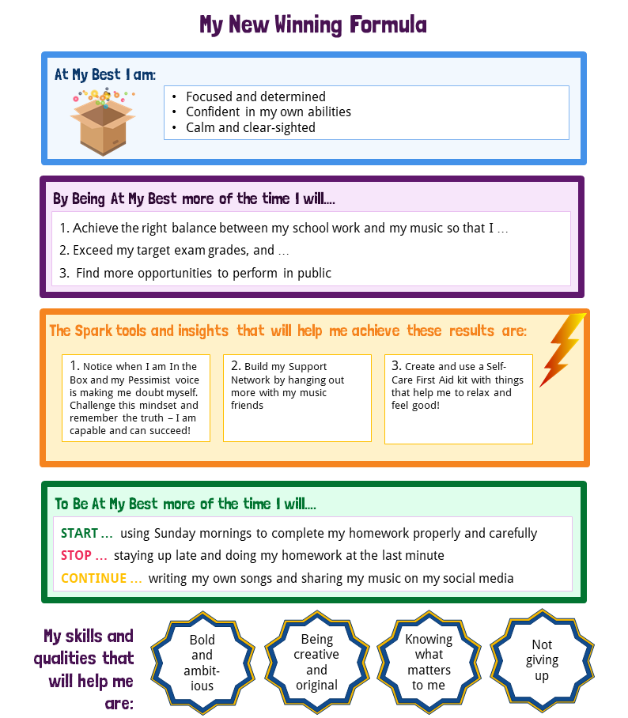
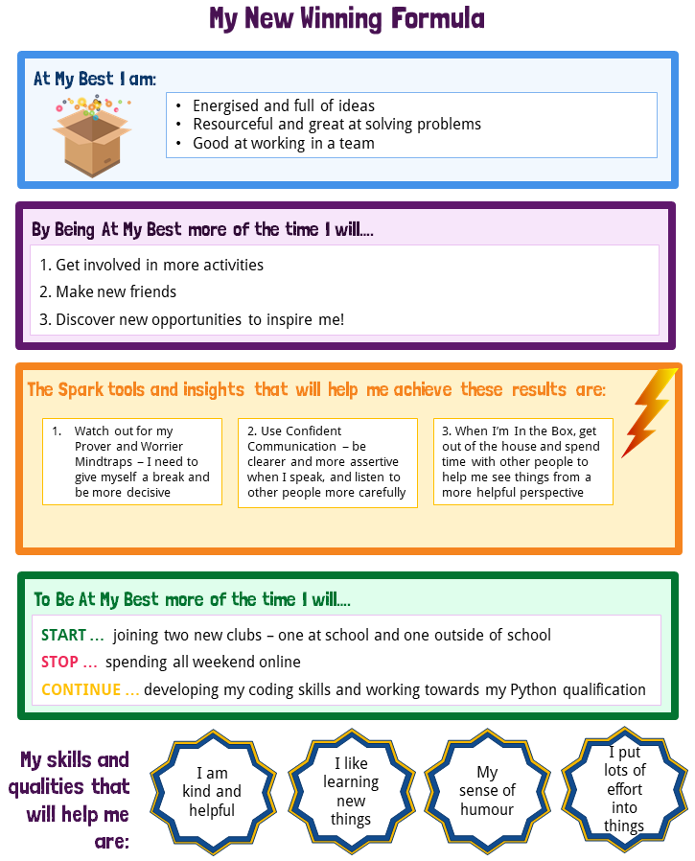
Exercise: Create your own winning formula
Follow the steps below to get clear on your winning formula and capture it on your Winning Formula certificate on the next page. Have a look at the examples at the bottom of the page if you need some help to get going.
STEP 1: Me At My Best
Start by reminding yourself how it feels to be At Your Best and Out of the Box. You might like to revisit the Word Cloud that you created in Session 5. Write down in the blue box on your certificate at least six words – thoughts and feelings that capture how you are At Your Best
STEP 2: My Results
How will it help you in life if you are able to Be At Your Best and most resourceful more often, even in difficult situations? What will you be able to achieve? Write down in the purple box on the certificate
three important ways in which this will help you. For example, it could be that you will be able to pursue and achieve an important goal, solve a particular problem or build your confidence.
STEP 3: The tools that will help me
Have a look back through your Programme materials and remind yourself of the key ideas and tools which you have learned. Which three will be most helpful to you in achieving the results you hope for? Write these down in the boxes on the yellow section of your certificate.
STEP 4: My commitment to action
What are the small steps or actions you can take right now, over the next days and weeks, to help you achieve the results you’re seeking and bring your Winning Formula to life? Identify one thing you will START doing, one thing you will STOP doing and one helpful thing you will CONTINUE. Write these down in the green section of the certificate.
STEP 5: My Winning Formula Qualities
Write down in the stars on the certificate some of the skills and qualities that you already have that will help you with your goal. We’d encourage you to ask a trusted friend or family member to suggest one or two. Often other people can more easily see some of the qualities that we don’t notice in ourselves.
STEP 6: Save your certificate to remind you of your Winning Formula
Print out your certificate to put on your wall, or save it on your phone to remind yourself of your Winning Formula and the commitments you’ve made to yourself to bring it to life.
Examples:

Slide 4
My Winning Formula
At My Best I am:
By Being At My Best more of the time I will….
1.
2.
3.
The Spark tools and insights that will help me achieve these results are:
1.
2.
3.
To Be At My Best more of the time I will….
START …
STOP …
CONTINUE …
My skills and qualities that will help me are:
I have completed the Jack Petchey Spark Programme!
Signed:
Date:

Slide 5
Congratulations!
Well done for completing the Jack Petchey Spark Programme. To have worked your way through the full programme is a fantastic achievement.
The insights and tools we have shared with you are exactly the same that we use in our work around the world with thousands of business and education leaders. Leaders in companies from Facebook to McDonalds, and BP to HSBC, have learned how to notice when they are In the Box and to use Check - Challenge - Choice to get Out of the Box and deal with stressful situations in a more resourceful way. The key to success is to keep practising. In time you will find that using your Spark tools becomes a natural part of your personal toolkit.
Don’t wait for a major stress or crisis to start using your Spark Programme tools. Remember, we all experience triggers and go In the Box on a daily basis. Start by noticing the small triggers. Take a breath and notice your feelings and your self talk (your Judge and Pessimist)
Keep these session packs to revisit and remind yourself of what you’ve learned, including the steps of the CCC Process.
Use your learning for yourself, not to correct other people! It’s almost always a bad idea to tell your friends, parents or teachers that they are In the Box!
But DO talk about what you’ve learned today with your parents, caregivers
or others. Explaining something to someone else is a great way to reinforce
your learning. Use the session materials to help you.
Share your Winning Formula and the actions that you’ve set yourself with a trusted friend or relative. Telling someone about a commitment you’ve made increases the chance of doing it by up to 95%!
Top tips
A tip from Sir Jack
Sir Jack Petchey has carried around a cut
out cardboard disc with a message to
himself in his pocket for most of his life.
Sir Jack believes that having a constant
reminder of the messages and mottos
he finds inspiring, such as “If you think
you can you can!” and “Don’t criticise,
condemn or complain”, have helped him
in reaching his goals through life. Having
the disc in his pocket acts as a tangible
reminder of the mindset and behaviour
he wants to demonstrate.
Sir Jack, who is
now over 90 years old, still carries around
a cardboard disc with a reminder on to
this day! Something as simple as this has
played a real part in his
success as a businessman
and philanthropist.
A final request
We would love to hear how you got on with the Spark Programme and how you think we could improve it for other young people. Please use this link to complete a short survey: https://forms.gle/trATENXdNrw4hs5X9
It should only take you ten minutes. You don’t need to give us your name and we really would appreciate it. Thank you.
Go Do!

